Slide 2
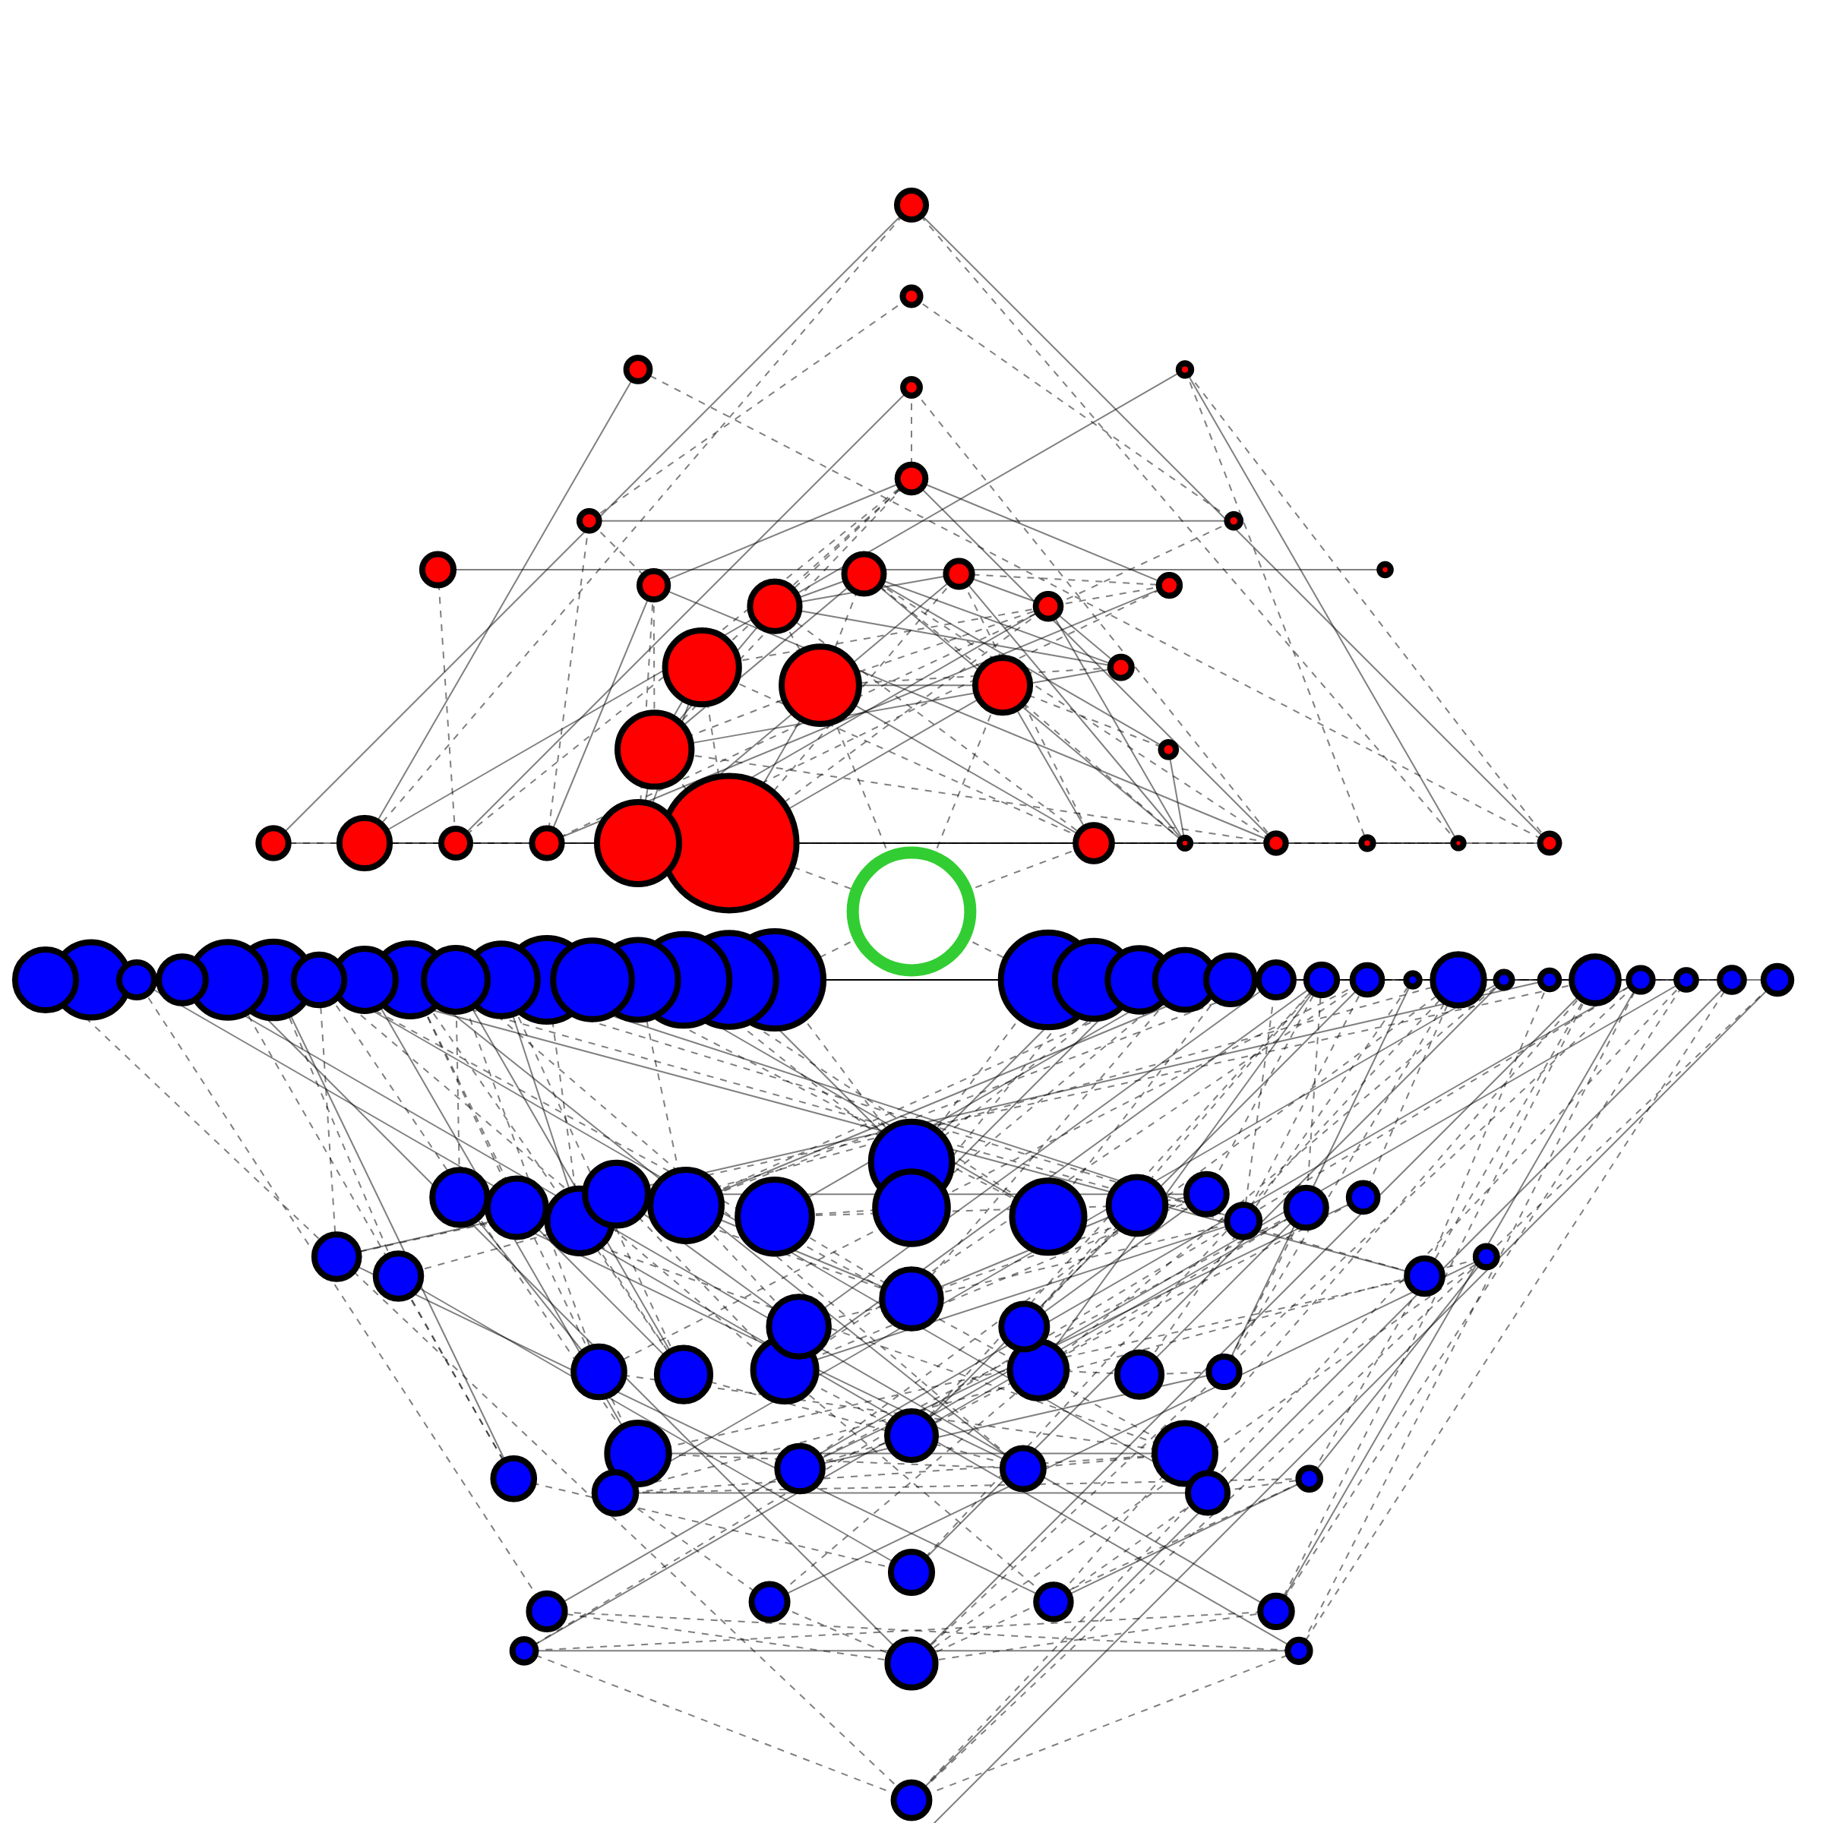
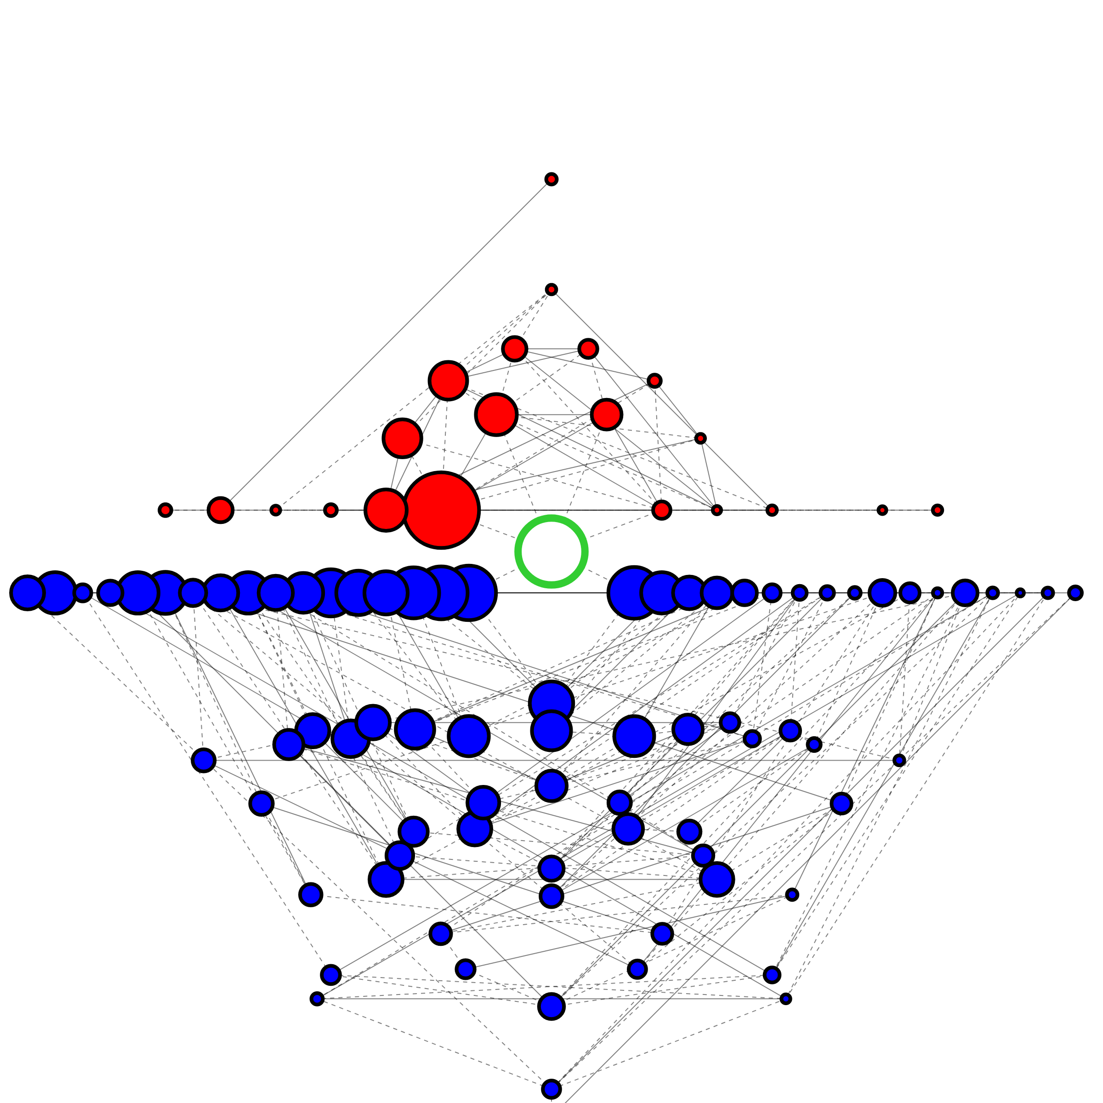


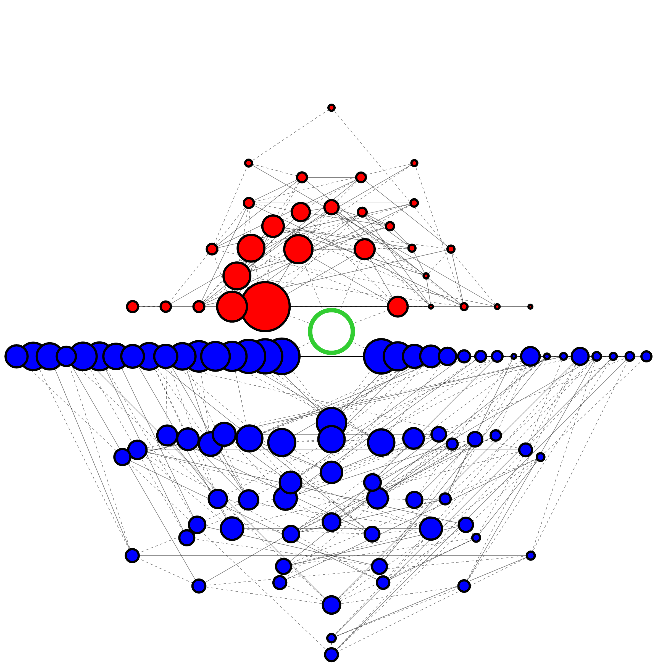
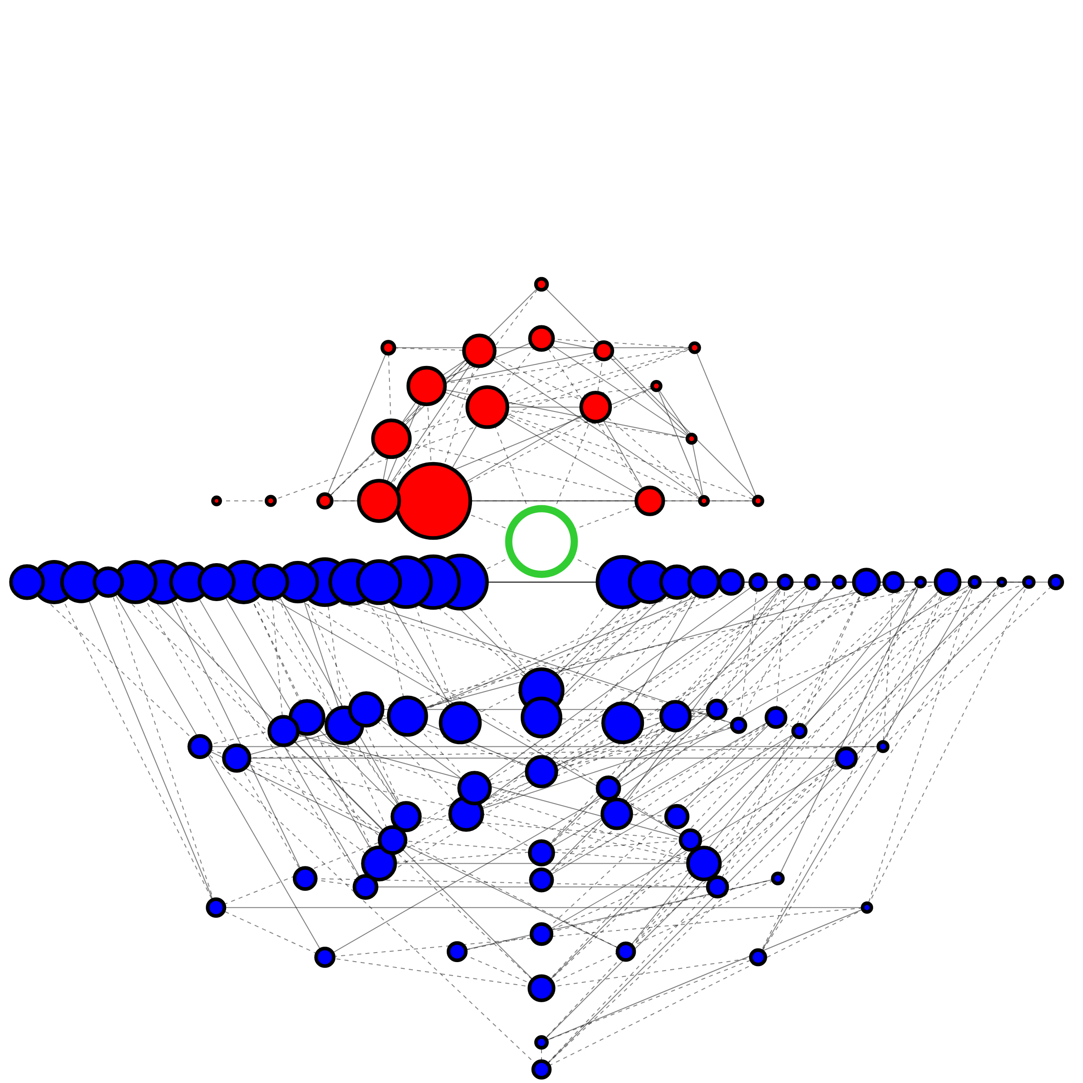
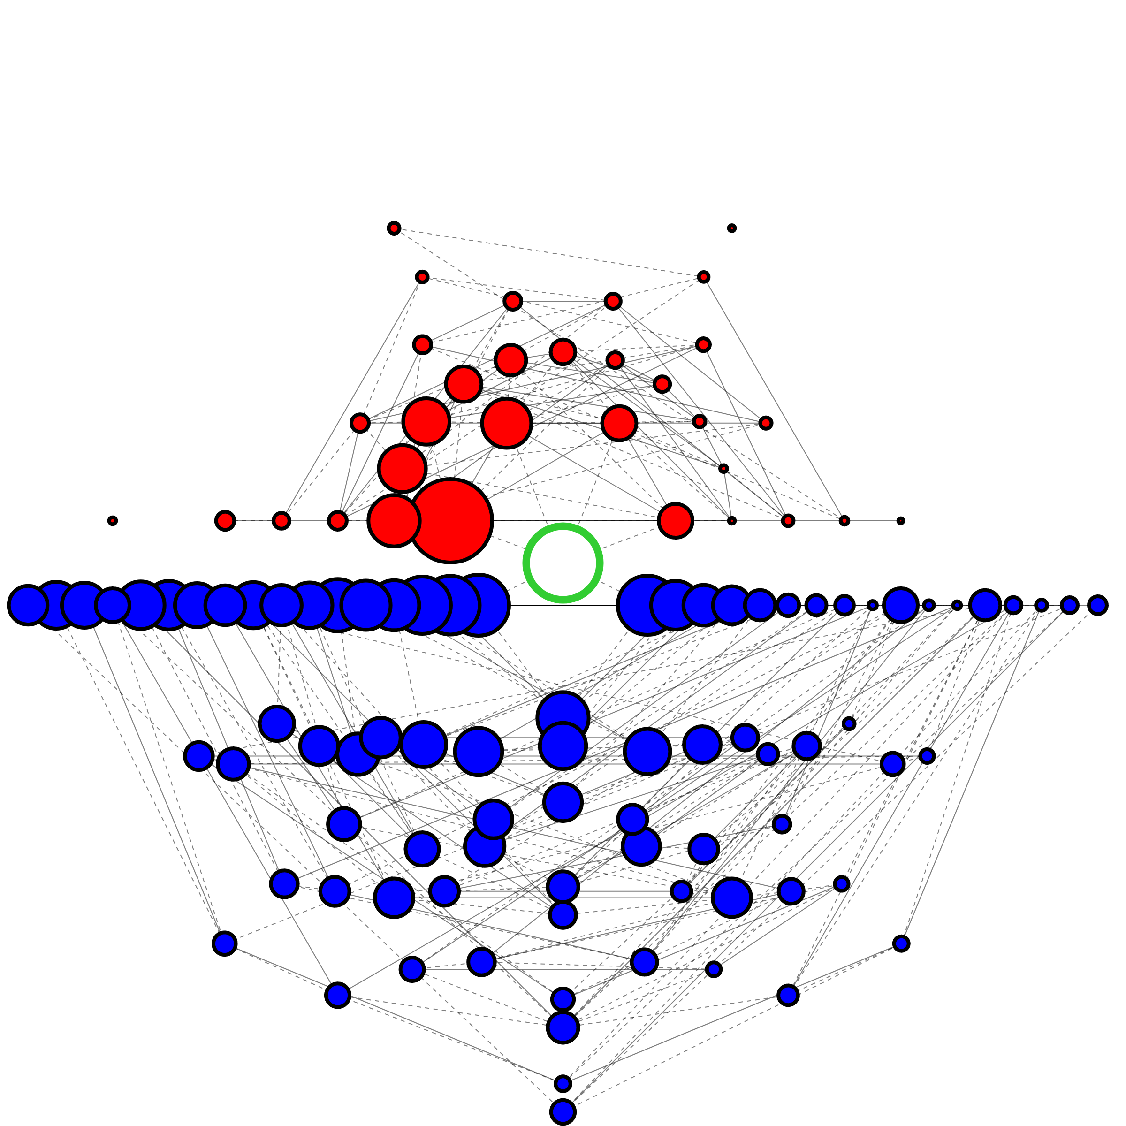
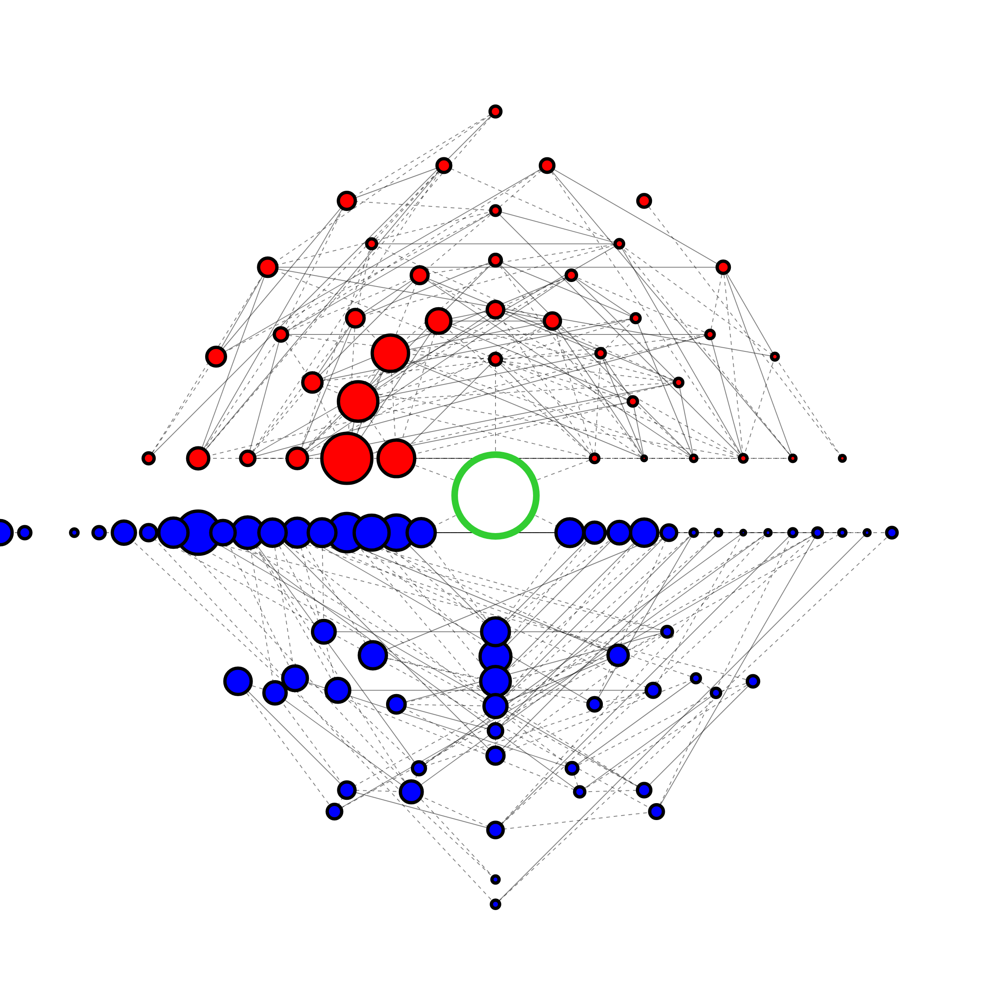
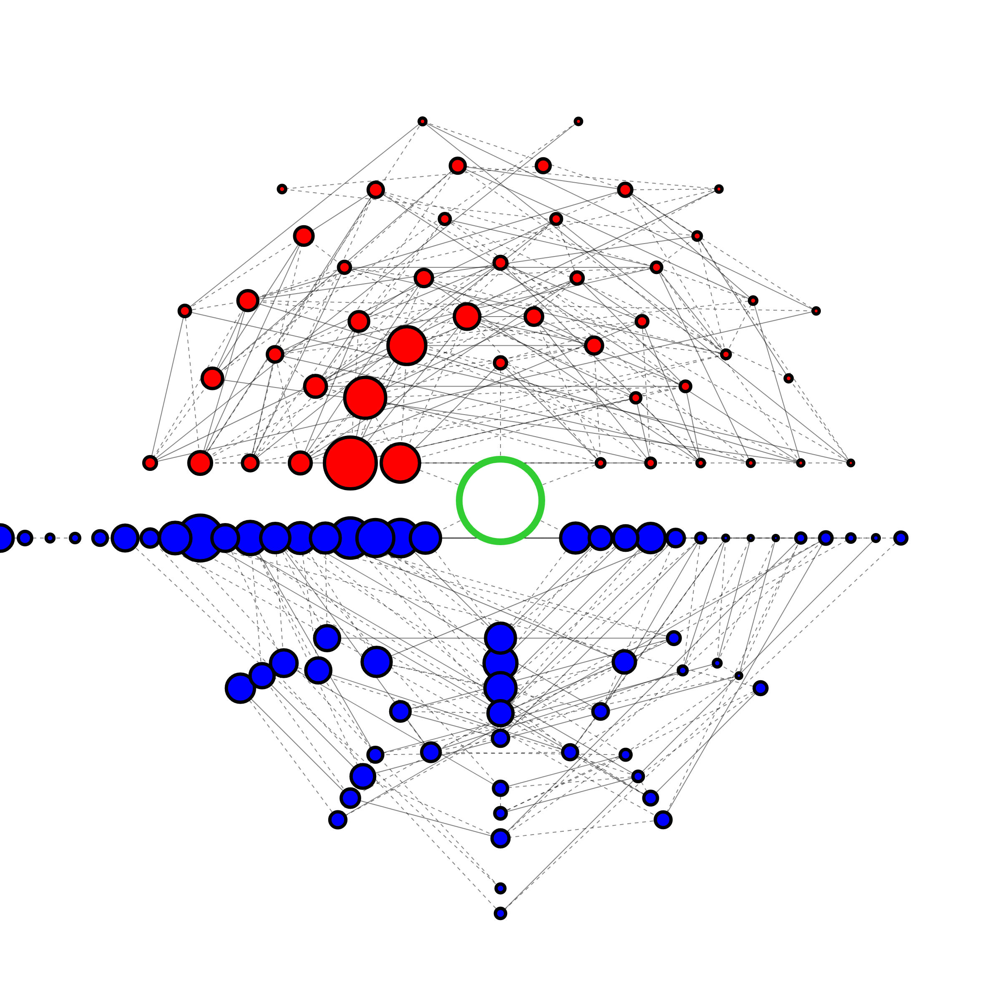
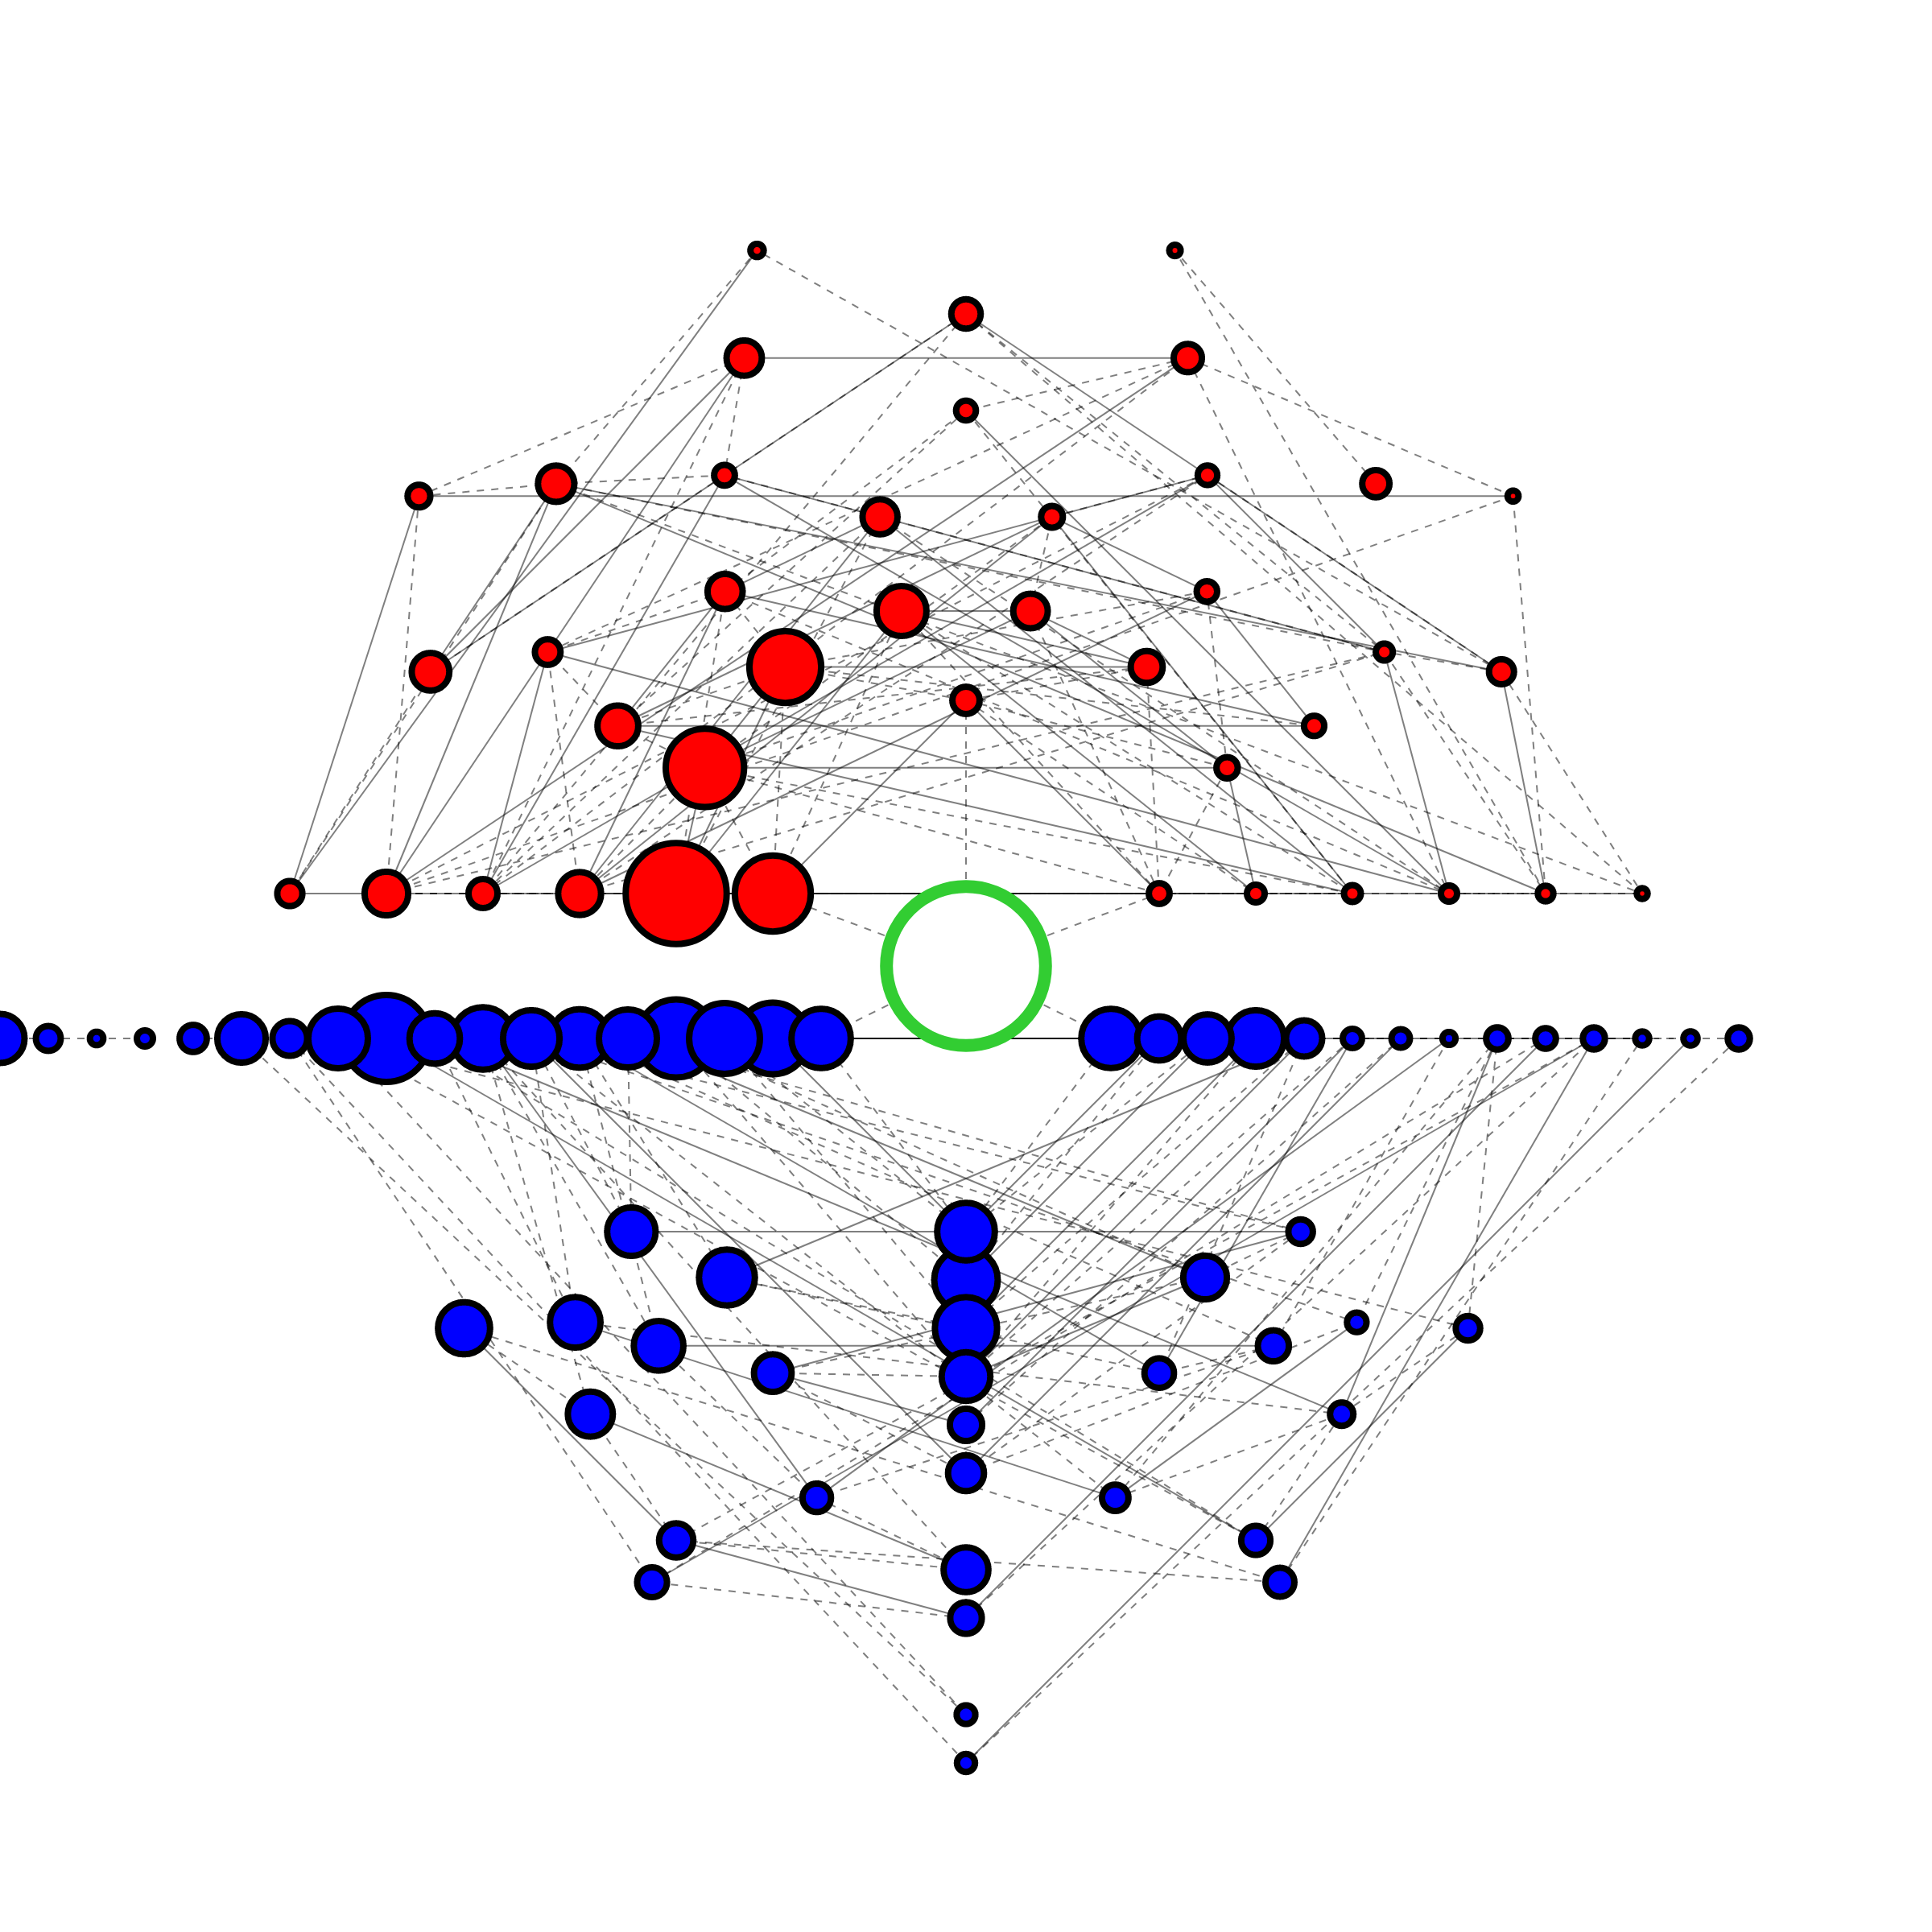
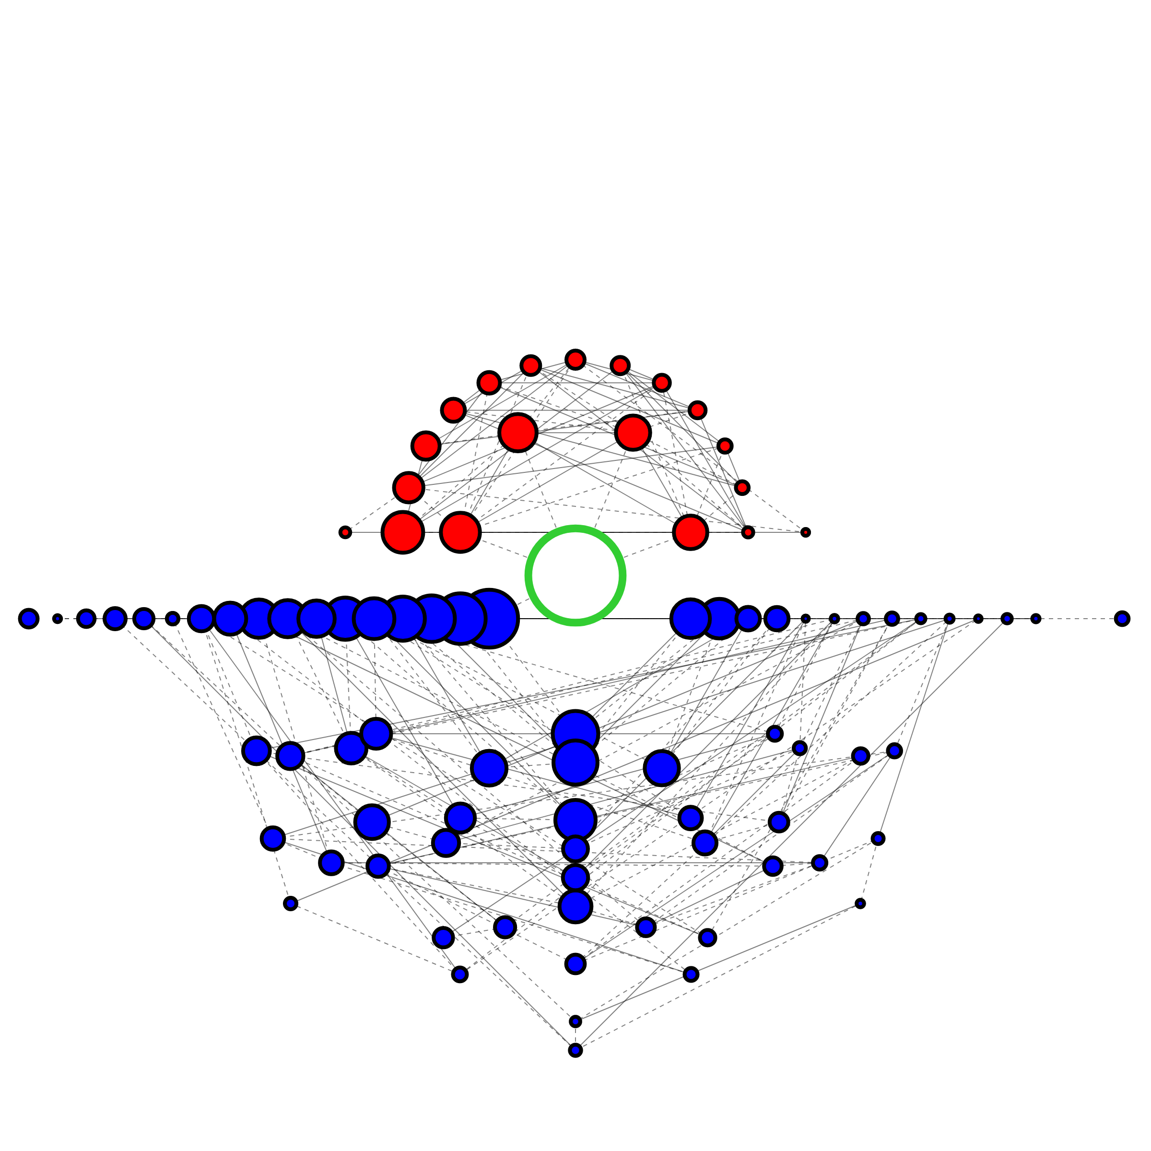
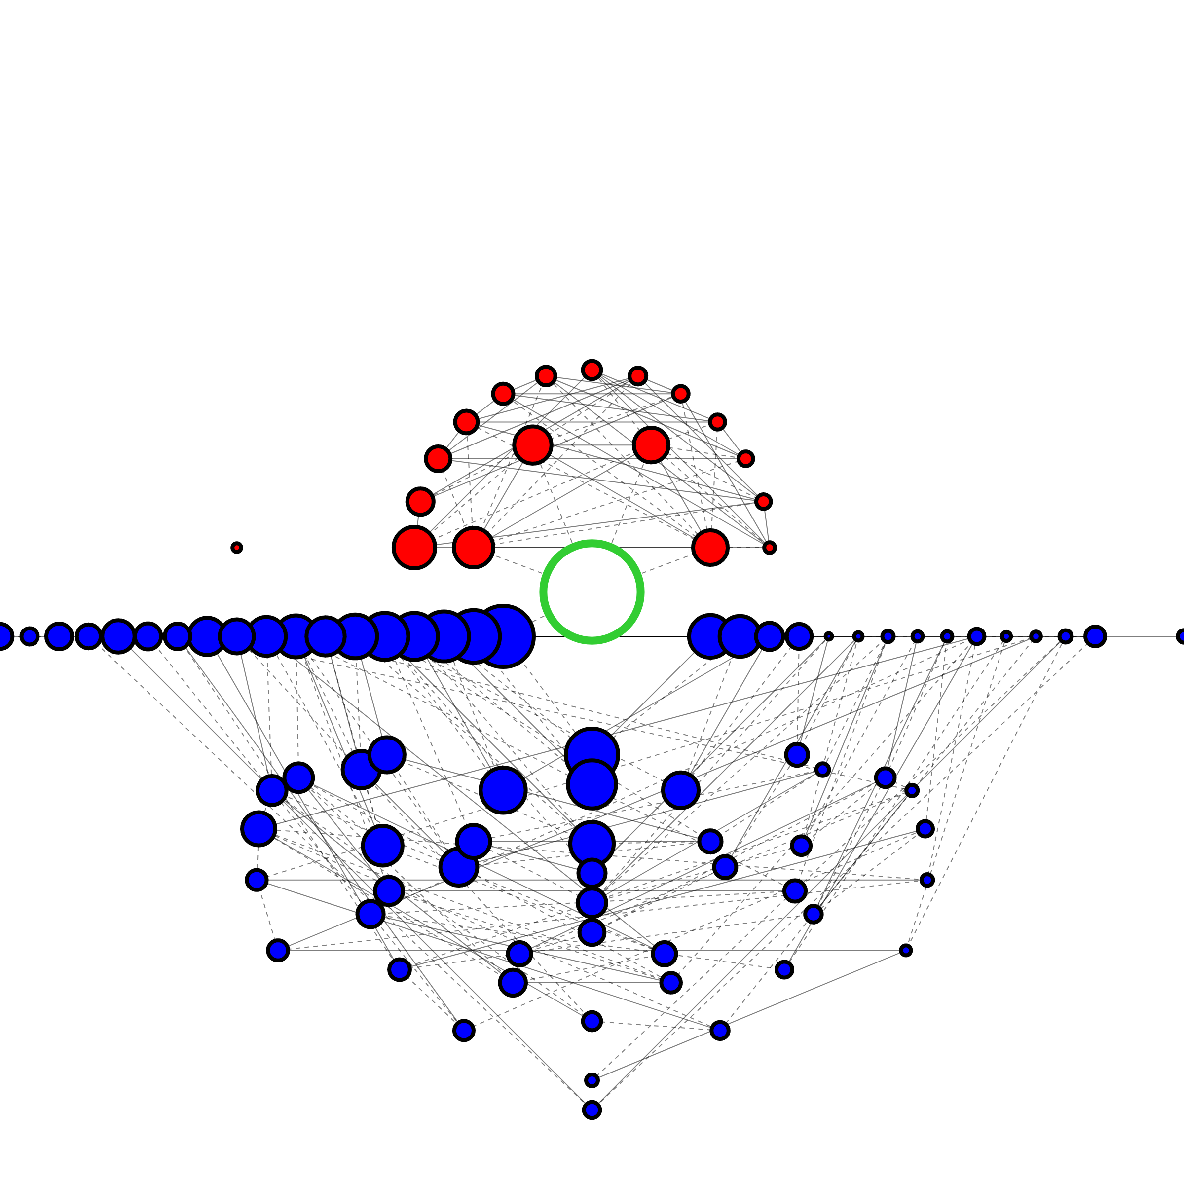
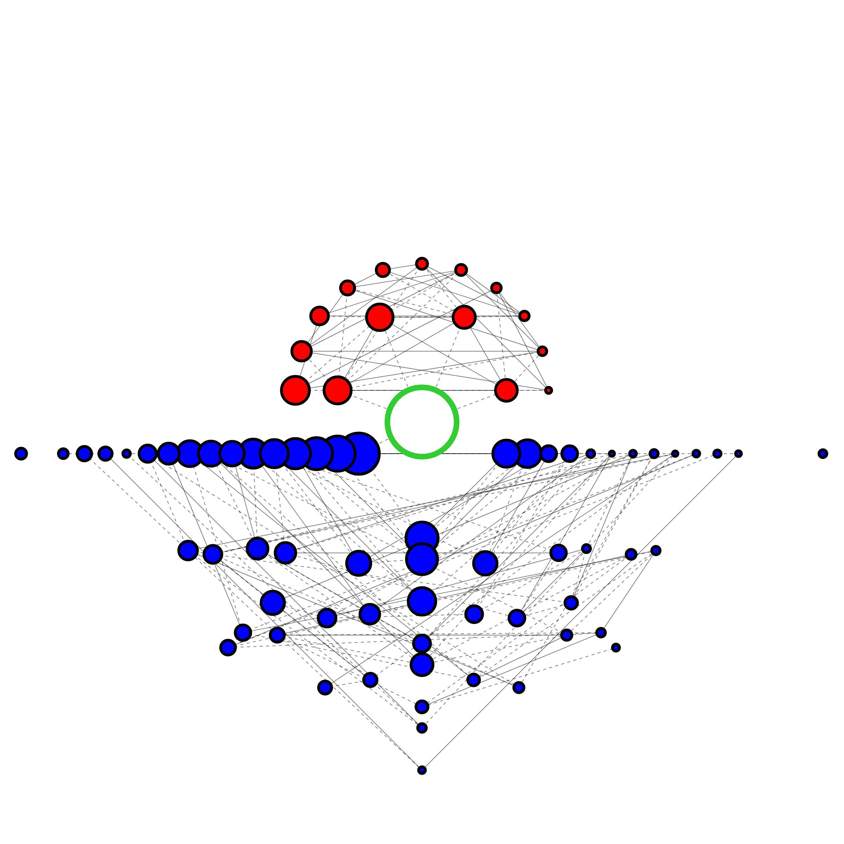
sgRNA A & B Forward strand Sense
sgRNA A & B Forward strand BranchΔ
sgRNA A & B Forward strand CMVΔ
Frequency Size Scale
Frequency Size Scale
≥1
≥1
10⁻¹
10⁻²
10⁻³
10⁻⁴
10⁻¹
≤10⁻⁵
10⁻²
10⁻³
10⁻⁴
≤10⁻⁵
Ratio [Sense / pCMV∆]
Ratio [Sense / pCMV∆]
3/2
5/4
1
4/5
3/2
2/3
5/4
sgRNA A & B Reverse strand Sense
sgRNA A & B Reverse strand BranchΔ
sgRNA A & B Reverse strand CMVΔ
1
4/5
2/3
Variation Types
Variation Types
Insertion
Deletion
Insertion
Deletion
None
None
Vertex Outline
Vertex Outline
Reference
Reference
Non-reference
Non-reference
Edge Types
Edge Types
sgRNA A Forward strand Sense
sgRNA A Forward strand BranchΔ
sgRNA A Forward strand CMVΔ
Substitution
In/del
Substitution
In/del
sgRNA B Reverse strand Sense
sgRNA B Reverse strand BranchΔ
sgRNA B Reverse strand CMVΔ

